Slide 1
"Page Optimization & User Engagement Strategy Analysis"
SAMUEL S

Slide 2
AGENDA
Introduction​
Data Exploration ​
Descriptive Analysis
​User Installation & Engagement Performance Analysis
Marketing Campaign Analysis ​
Recommendations
Deliverables

Slide 3
Introduction
This analysis focuses on optimizing pages and enhancing user engagement for both the app and website of XYZ Inc. Through data analysis, we aim to uncover insights that drive more installations and boost user engagement. By understanding user behavior and preferences, we can develop effective strategies to optimize page performance and maximize user interaction, ultimately contributing to the company's growth and success.

Slide 4
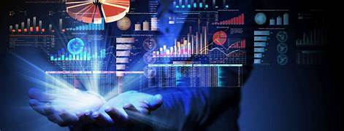
Data Exploration (Uncovering Insights and Enhancing Data Quality )
In this phase, we thoroughly examine the dataset to understand all variables and assess data quality. We meticulously handle missing values and format the data for analysis. Our goal is to identify the most relevant variables that can significantly impact our business outcomes, enabling us to make informed decisions to optimize performance and drive growth

Slide 5
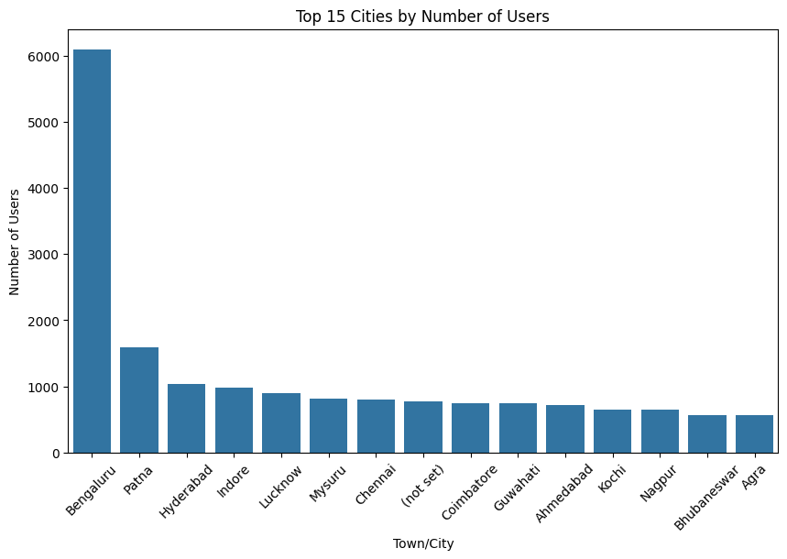
Descriptive Analysis
In this phase, we conduct an exploratory data analysis to gain deep insights into the dataset. Our focus is on identifying sales trends, patterns, and outliers. Utilizing various visualization techniques such as charts and graphs, we effectively present our findings to uncover valuable insights crucial for strategic decision-making

Slide 6
User Installation & Engagement Performance Analysis
Region India, particularly Bangalore, exhibits the highest user concentration. Key metrics like engaged sessions, engagement rate, and new users correlate positively with sales. Targeted marketing in high-user regions and improving product engagement can directly impact sales performance.
The correlation between user engagement metrics such as engaged sessions per user, average engagement time, and event count with sales underscores the importance of fostering a positive user experience. By continuously refining product attributes to enhance user engagement and tailoring marketing efforts to regions with high user concentrations, businesses can drive sustained sales growth.

Slide 7
Marketing Campaign Analysis ​
The "App Installation for May --Shahid " campaign in May resulted in 5,429 app installations with a conversion rate of 1.22%. It boasted an impressive ROI of 14.62, indicating cost-effectiveness. The campaign's success can be attributed to effective messaging and targeting. To improve, further audience refinement and creative optimization could be explored.
“ Through comprehensive analysis of our marketing campaigns, we identify key performance drivers and areas for improvement, leveraging insights to refine targeting strategies and optimize resource allocation. By aligning campaign objectives with customer preferences and market trends, we aim to enhance brand visibility, drive customer engagement, and ultimately, maximize conversion rates for sustainable business growth .”

Slide 8
Recommendations
Targeted Marketing Campaigns: Utilize insights from high-performing language segments to tailor marketing efforts, allocating resources towards channels with the highest engagement rates and optimizing messaging to resonate with specific language demographics.
Enhanced Localization Efforts: Invest in comprehensive localization strategies to cater to diverse language preferences, including translating content, adapting user interfaces, and culturally relevant marketing campaigns, thereby increasing accessibility and appeal to a broader audience.
Continuous Performance Monitoring:
Implement robust analytics tools to track the effectiveness of marketing initiatives in real-time, enabling swift adjustments based on evolving customer preferences and market trends, ultimately driving increased sales and revenue growth.

Slide 9





Recommendations
PLANNING
MARKETING
DESIGN
STRATEGY
LAUNCH
The process of organizing actions and resources to achieve specific goals or objectives.
The practice of promoting products or services to attract and retain customers, often involving market research, advertising, and branding.
A plan of action designed to achieve a long-term goal or objective, typically involving careful planning, resource allocation, and decision-making.
The creation of products, services, or experiences with a focus on functionality, aesthetics, and user experience.
The process of introducing a new product, service, or initiative to the market, often involving preparation, execution, and evaluation.

Slide 10
Deliverables
Utilizing insights from user engagement metrics, advertising campaign performance, and language preferences, our deliverables focus on refining user experiences, optimizing advertising strategies, and tailoring content to diverse language demographics. By enhancing engagement, targeting ad spend effectively, and catering to multilingual audiences, our initiatives aim to drive sustainable business growth and maximize ROI.

Slide 11
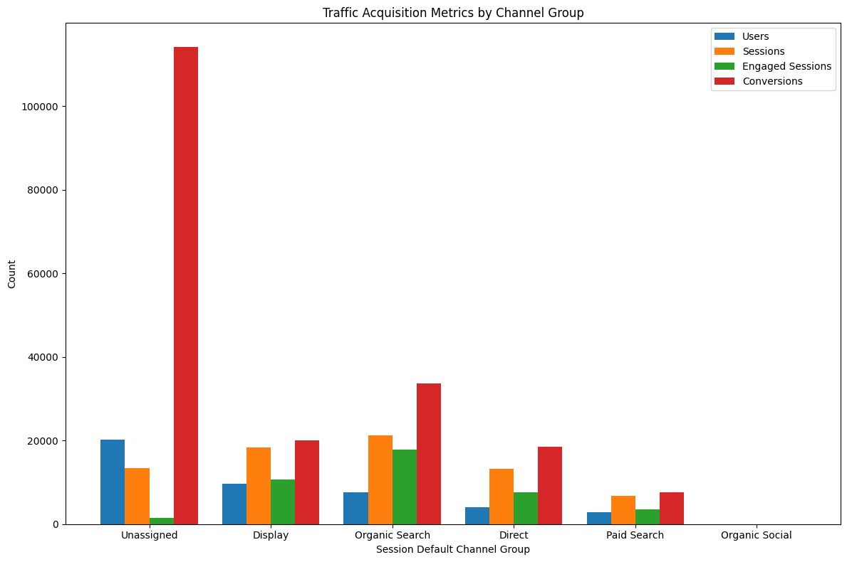
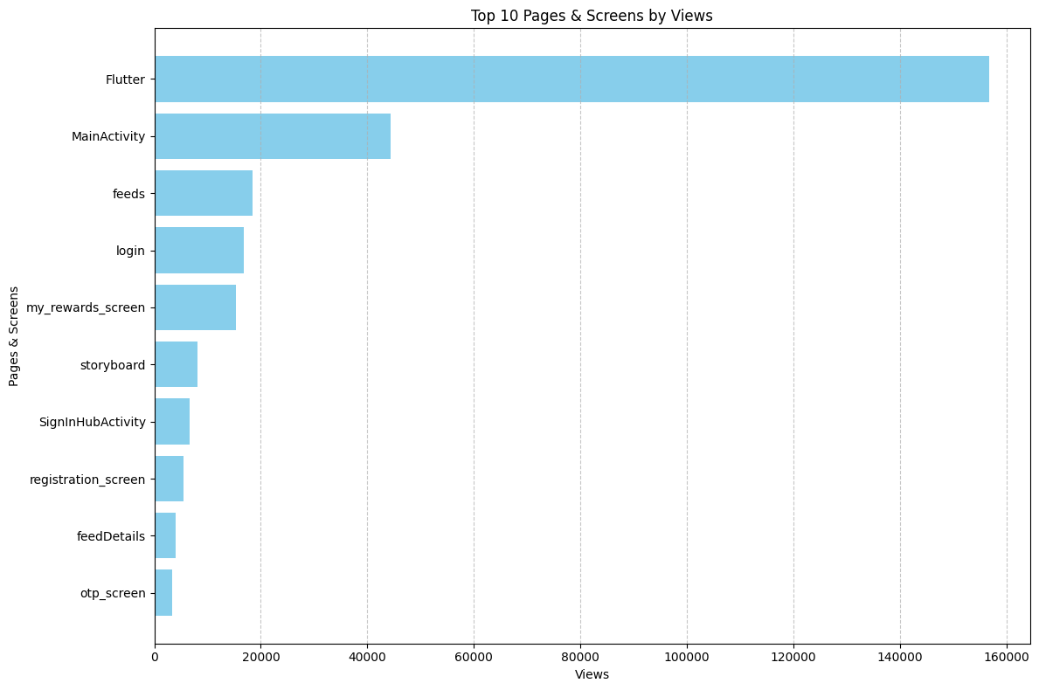
Develop a personalized marketing platform that optimizes engagement by targeting users based on their preferred traffic acquisition channels. Another idea is to create an analytics dashboard specifically tailored for businesses to track and optimize their online marketing strategies across various traffic sources.
Implement personalized recommendations and interactive features on the most viewed pages/screens to increase engagement and drive conversions, ultimately boosting sales and fostering customer loyalty.

Slide 12
SUMMARY
Through comprehensive analysis of various data sets including conversion rates, campaign performance, language preferences, and top pages/screens, it's evident that optimizing user experience, targeting effective advertising channels, and tailoring content to diverse linguistic preferences are pivotal for maximizing business growth and enhancing customer engagement in the competitive market landscape.

Slide 13
THANK YOU
SAMUEL S​
morlensamuels@gmail.com

